Slide 1

POI Pointer – team65
http://poipointer.github.io/
@CerealKill-R – Julien Remy
@cyrillef – Cyrille, Autodesk
@djodjoni – Kalin Maldzhanski
@flyos777 – Flavien Roelandt
@jeremytammik – Jeremy Tammik, Autodesk

Slide 2
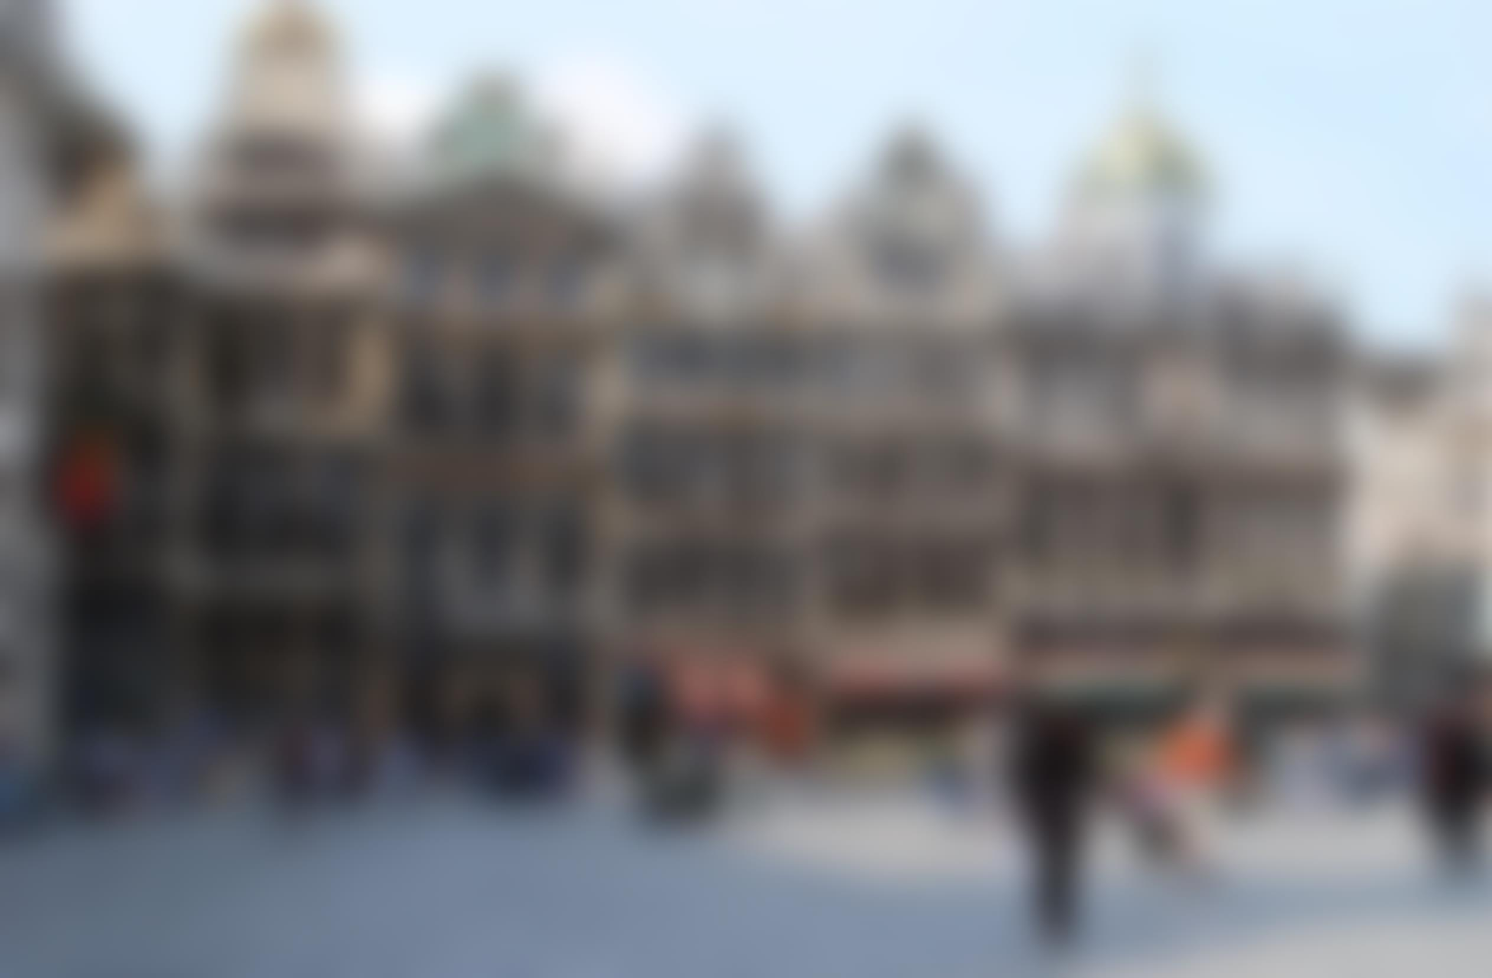
« the ‘cultural’ Tinder »

Slide 3
POI Pointer
Suggest suitable points of interest nearby.
This app helps you locate all the beauties in Brussels that usually go unnoticed.
Use this iOS or Android app when you have time on your hands to explore, be surprised and impressed.
When entering a specific perimeter around one of those beauties – e.g., a statue, a monument, etc. – PoiPointer will notify you, provide information and guide you to the targeted place.

Slide 4
Technical aspects
Deal with data formated in different ways
Combine the datasets --> create a unique model to fit them all in
Elastic Search as data source
Data indexation by geolocation
Addition of extra information into our repository (url, img, …)

Slide 5





Datasets
Theatres
Museums
Monuments
Comics
Fountains
7 datasets in total : 6 from the Region and 1 from URBIS

Slide 6
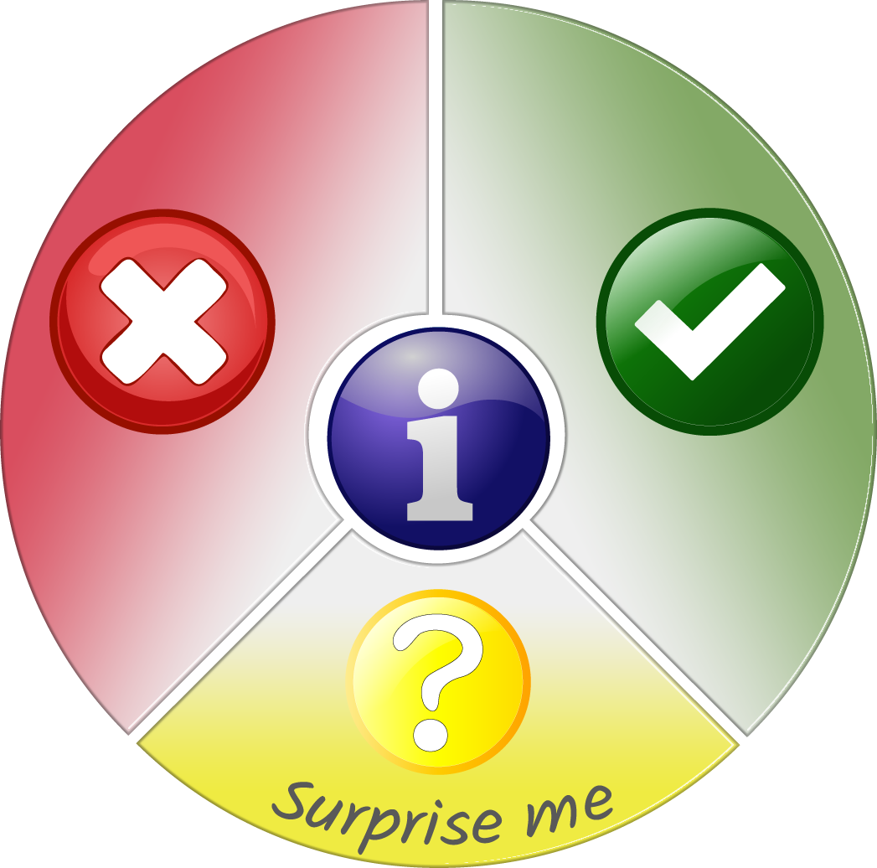

Usability (UX)
OR

Slide 7

See the demo

